Slide 1
Projective 2D geometry course 2
Multiple View Geometry
Comp 290-089
Marc Pollefeys

Slide 2
Content
Background: Projective geometry (2D, 3D), Parameter estimation, Algorithm evaluation.
Single View: Camera model, Calibration, Single View Geometry.
Two Views: Epipolar Geometry, 3D reconstruction, Computing F, Computing structure, Plane and homographies.
Three Views: Trifocal Tensor, Computing T.
More Views: N-Linearities, Multiple view reconstruction, Bundle adjustment, auto-calibration, Dynamic SfM, Cheirality, Duality

Slide 3
Multiple View Geometry course schedule
(tentative)
Jan. 7, 9 | Intro & motivation | Projective 2D Geometry
Jan. 14, 16 | (no course) | Projective 2D Geometry
Jan. 21, 23 | Projective 3D Geometry | Parameter Estimation
Jan. 28, 30 | Parameter Estimation | Algorithm Evaluation
Feb. 4, 6 | Camera Models | Camera Calibration
Feb. 11, 13 | Single View Geometry | Epipolar Geometry
Feb. 18, 20 | 3D reconstruction | Fund. Matrix Comp.
Feb. 25, 27 | Structure Comp. | Planes & Homographies
Mar. 4, 6 | Trifocal Tensor | Three View Reconstruction
Mar. 18, 20 | Multiple View Geometry | MultipleView Reconstruction
Mar. 25, 27 | Bundle adjustment | Papers
Apr. 1, 3 | Auto-Calibration | Papers
Apr. 8, 10 | Dynamic SfM | Papers
Apr. 15, 17 | Cheirality | Papers
Apr. 22, 24 | Duality | Project Demos

Slide 4



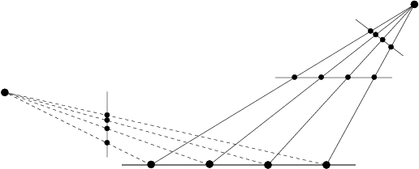
Projective 2D Geometry
Points, lines & conics
Transformations & invariants
1D projective geometry and
the Cross-ratio

Slide 5










Homogeneous coordinates
Homogeneous representation of lines
equivalence class of vectors, any vector is representative
Set of all equivalence classes in R³−(0,0,0)^{T} forms P²
Homogeneous representation of points
on
if and only if
The point x lies on the line l if and only if x^{T}l=l^{T}x=0
Homogeneous coordinates
but only 2DOF
Inhomogeneous coordinates

Slide 6







Points from lines and vice-versa
Intersections of lines
The intersection of two lines and is
Line joining two points
The line through two points and is
Example

Slide 7








Ideal points and the line at infinity
Intersections of parallel lines
Example
tangent vector
normal direction
Ideal points
Line at infinity
Note that in P² there is no distinction
between ideal points and others

Slide 8
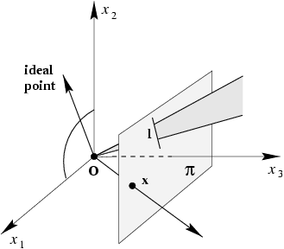
A model for the projective plane
exactly one line through two points
exaclty one point at intersection of two lines

Slide 9





Duality
Duality principle:
To any theorem of 2-dimensional projective geometry there corresponds a dual theorem, which may be derived by interchanging the role of points and lines in the original theorem

Slide 10

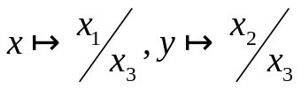
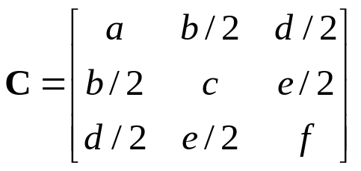


Conics
Curve described by 2nd-degree equation in the plane
or homogenized
or in matrix form
with
5DOF:

Slide 11



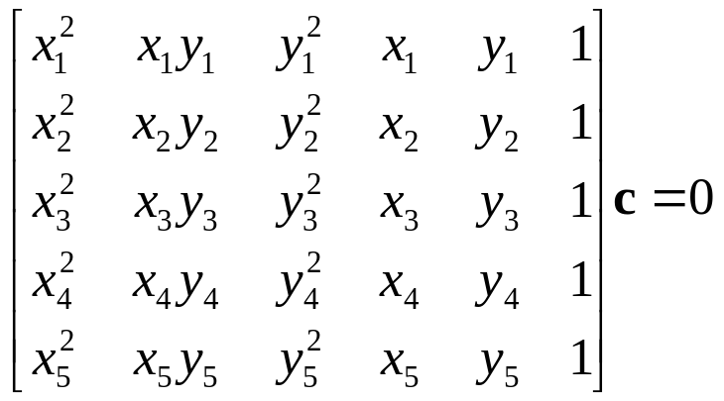
Five points define a conic
For each point the conic passes through
or
stacking constraints yields

Slide 12
Tangent lines to conics
The line l tangent to C at point x on C is given by l=Cx
l
x
C

Slide 13


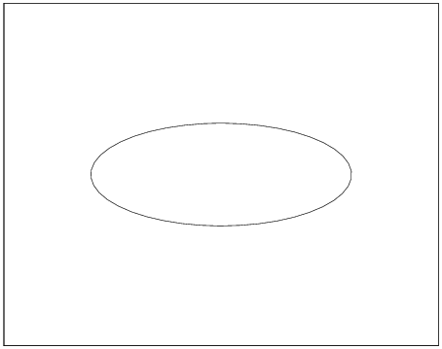
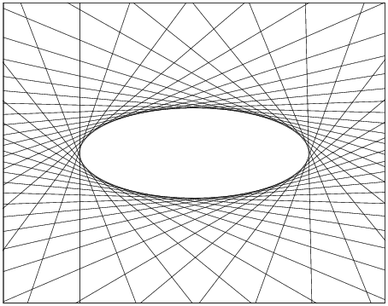
Dual conics
A line tangent to the conic C satisfies
In general (C full rank):
Dual conics = line conics = conic envelopes

Slide 14




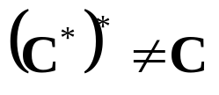
Degenerate conics
A conic is degenerate if matrix C is not of full rank
e.g. two lines (rank 2)
e.g. repeated line (rank 1)
Degenerate line conics: 2 points (rank 2), double point (rank1)
Note that for degenerate conics

Slide 15
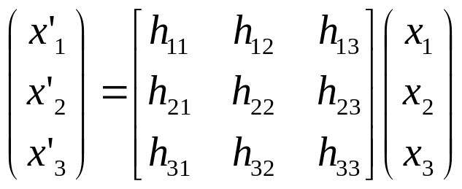

Projective transformations
Definition:
A projectivity is an invertible mapping h from P² to itself such that three points x₁,x₂,x₃ lie on the same line if and only if h(x₁),h(x₂),h(x₃) do.
Theorem:
A mapping h:P²→P² is a projectivity if and only if there exist a non-singular 3x3 matrix H such that for any point in P² reprented by a vector x it is true that h(x)=Hx
Definition: Projective transformation
or
8DOF
projectivity=collineation=projective transformation=homography

Slide 16
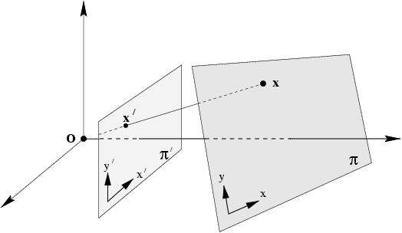
Mapping between planes
central projection may be expressed by x’=Hx
(application of theorem)

Slide 17
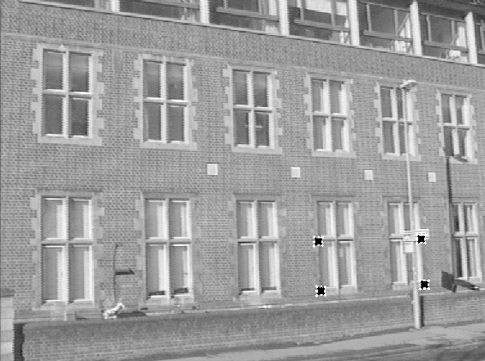
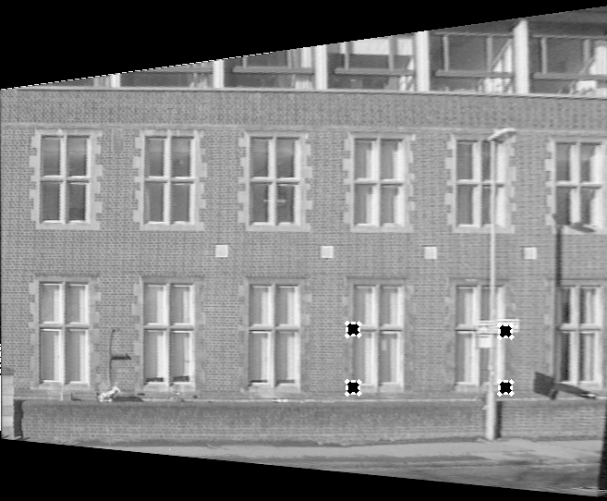
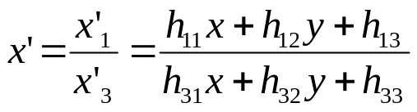
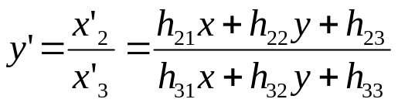

Removing projective distortion
select four points in a plane with know coordinates
(linear in h_{ij})
(2 constraints/point, 8DOF ⇒ 4 points needed)
Remark: no calibration at all necessary,
better ways to compute (see later)

Slide 18
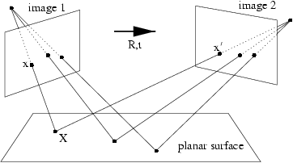
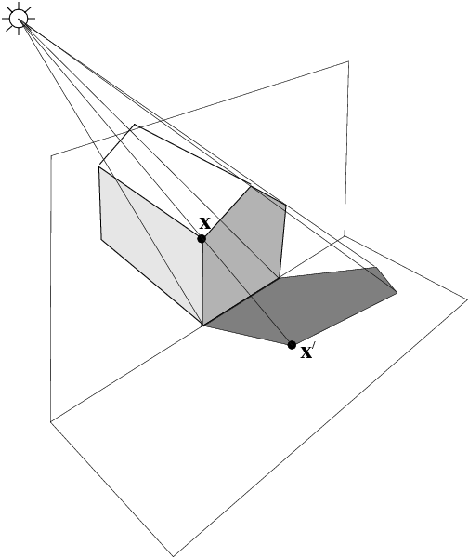
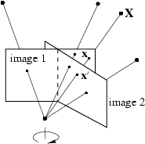
More examples

Slide 19




Transformation of lines and conics
For a point transformation
Transformation for lines
Transformation for conics
Transformation for dual conics

Slide 20
A hierarchy of transformations
Projective linear group
Affine group (last row (0,0,1))
Euclidean group (upper left 2x2 orthogonal)
Oriented Euclidean group (upper left 2x2 det 1)
Alternative, characterize transformation in terms of elements or quantities that are preserved or invariant
e.g. Euclidean transformations leave distances unchanged

Slide 21
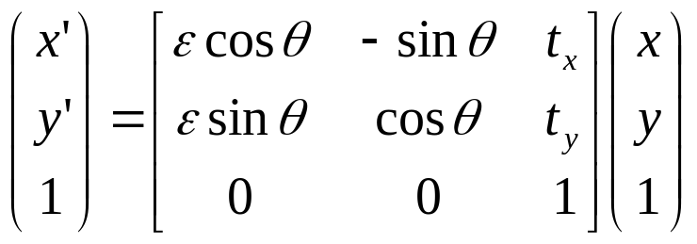



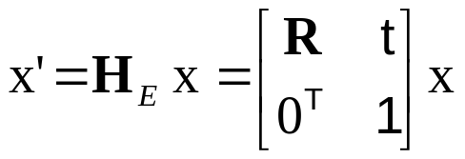

Class I: Isometries
(iso=same, metric=measure)
orientation preserving:
orientation reversing:
3DOF (1 rotation, 2 translation)
special cases: pure rotation, pure translation
Invariants: length, angle, area

Slide 22
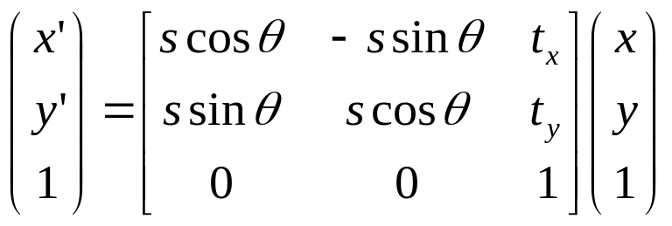
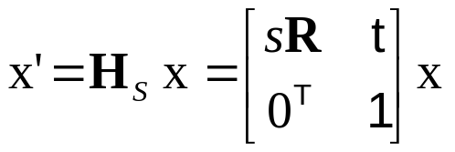
Class II: Similarities
(isometry + scale)
4DOF (1 scale, 1 rotation, 2 translation)
also know as equi-form (shape preserving)
metric structure = structure up to similarity (in literature)
Invariants: ratios of length, angle, ratios of areas, parallel lines

Slide 23
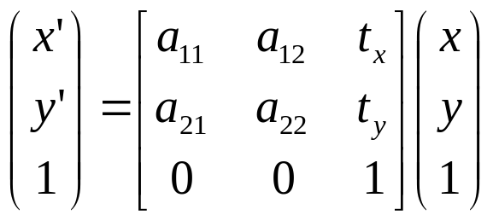
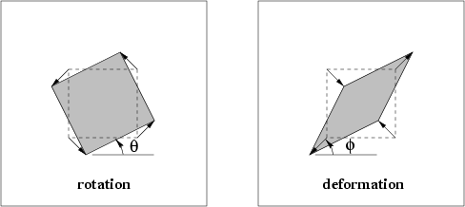
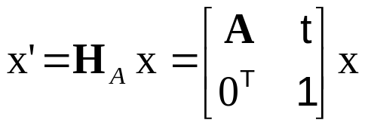
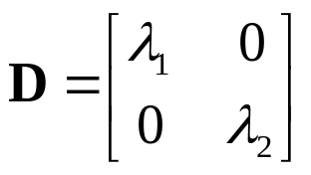

Class III: Affine transformations
6DOF (2 scale, 2 rotation, 2 translation)
non-isotropic scaling! (2DOF: scale ratio and orientation)
Invariants: parallel lines, ratios of parallel lengths,
ratios of areas

Slide 24
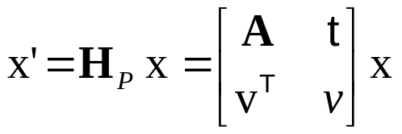

Class VI: Projective transformations
8DOF (2 scale, 2 rotation, 2 translation, 2 line at infinity)
Action non-homogeneous over the plane
Invariants: cross-ratio of four points on a line
(ratio of ratio)

Slide 25
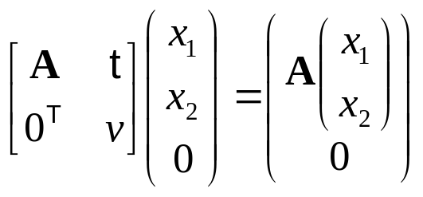
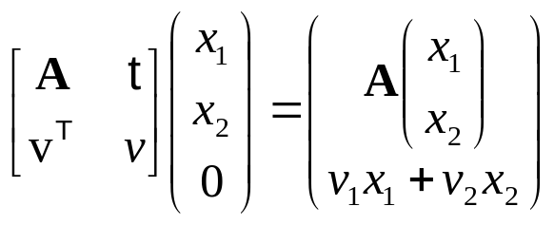
Action of affinities and projectivities on line at infinity
Line at infinity stays at infinity,
but points move along line
Line at infinity becomes finite,
allows to observe vanishing points, horizon,

Slide 26
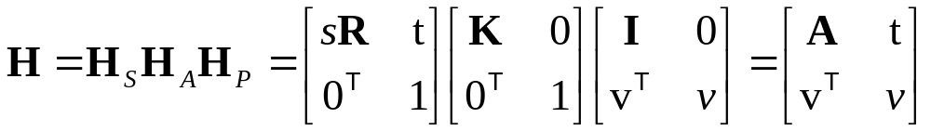



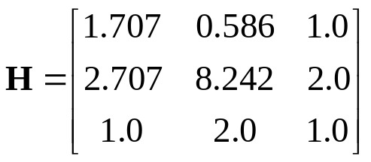
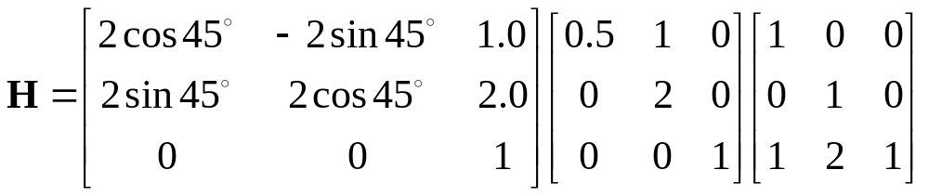
Decomposition of projective transformations
decomposition unique (if chosen s>0)
upper-triangular,
Example:

Slide 27
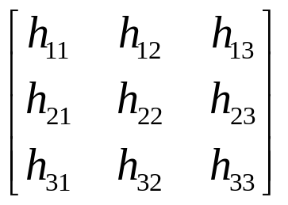
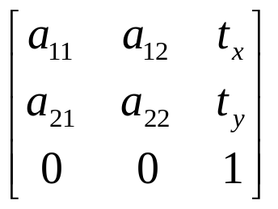
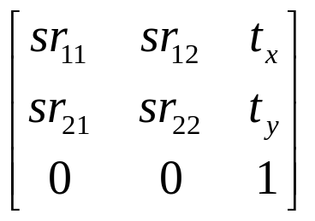
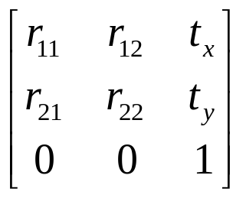
Overview transformations
Concurrency, collinearity, order of contact (intersection, tangency, inflection, etc.), cross ratio
Projective
8dof
Parallellism, ratio of areas, ratio of lengths on parallel lines (e.g midpoints), linear combinations of vectors (centroids).
The line at infinity l∞
Affine
6dof
Similarity
4dof
Ratios of lengths, angles.
The circular points I,J
Euclidean
3dof
lengths, areas.

Slide 28
Number of invariants?
The number of functional invariants is equal to, or greater than, the number of degrees of freedom of the configuration less the number of degrees of freedom of the transformation
e.g. configuration of 4 points in general position has 8 dof (2/pt)
and so 4 similarity, 2 affinity and zero projective invariants

